Slide 1
Managing Change and Innovation
Chapter
13
© 2007 Prentice Hall, Inc.
All rights reserved.

Slide 2
L E A R N I N G O U T L I N E
Follow this Learning Outline as you read and study this chapter.
Forces for Change: Two Views of the Change Process
  Discuss the external and internal forces for change.
  Contrast the calm waters and white-water rapids metaphors of change.
  Explain Lewin’s three-step model of the change process.
Managing Organizational Change
  Define organizational change.
  Contrast internal and external change agents.
  Explain how managers might change structure, technology, and people.
© 2007 Prentice Hall, Inc. All rights reserved.
13–<number>

Slide 3
L E A R N I N G O U T L I N E (cont’d)
Follow this Learning Outline as you read and study this chapter.
Managing Change
  Explain why people resist change and how resistance might be managed.
Contemporary Issues in Managing Change
  Explain why changing organizational culture is so difficult and how managers can do it.
  Describe employee stress and how managers can help employees deal with stress.
  Discuss what it takes to make change happen successfully.
© 2007 Prentice Hall, Inc. All rights reserved.
13–<number>

Slide 4
L E A R N I N G O U T L I N E (cont’d)
Follow this Learning Outline as you read and study this chapter.
Stimulating Innovation
  Explain why innovation isn’t just creativity.
  Explain the systems view of innovation.
  Describe the structural, cultural, and human resource variables that are necessary for innovation.
  Explain what idea champions are and why they’re important to innovation.
© 2007 Prentice Hall, Inc. All rights reserved.
13–<number>

Slide 5
What Is Change?
Organizational Change
  Any alterations in the people, structure, or technology of an organization
Characteristics of Change
  Is constant yet varies in degree and direction
  Produces uncertainty yet is not completely unpredictable
  Creates both threats and opportunities
Managing change is an integral part
of every manager’s job.
© 2007 Prentice Hall, Inc. All rights reserved.
13–<number>

Slide 6
Forces for Change
External Forces
  Marketplace
  Governmental laws and regulations
  Technology
  Labor market
  Economic changes
Internal Forces
  Changes in organizational strategy
  Workforce changes
  New equipment
  Employee attitudes
© 2007 Prentice Hall, Inc. All rights reserved.
13–<number>

Slide 7
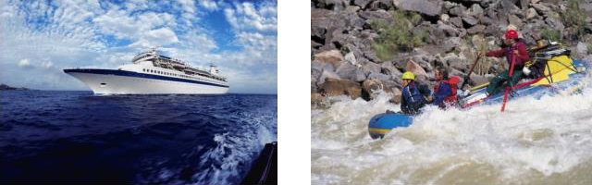
Change Process Viewpoints
The Calm Waters Metaphor
  Lewin’s description of the change process as a break in the organization’s equilibrium state
    Unfreezing the status quo
    Changing to a new state
    Refreezing to make the change permanent
White-Water Rapids Metaphor
  The lack of environmental stability and predictability requires that managers and organizations continually adapt (manage change actively) to survive.
© 2007 Prentice Hall, Inc. All rights reserved.
13–<number>

Slide 8
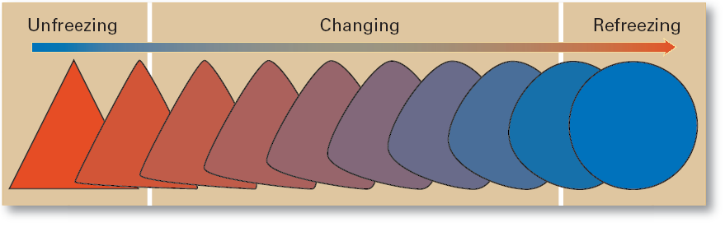
Exhibit 13–1 The Change Process
© 2007 Prentice Hall, Inc. All rights reserved.
13–<number>

Slide 9
Change Agents
Change Agents
  Persons who act as catalysts and assume the responsibility for managing the change process.
Types of Change Agents
  Managers: internal entrepreneurs
  Nonmanagers: change specialists
  Outside consultants: change implementation experts
© 2007 Prentice Hall, Inc. All rights reserved.
13–<number>

Slide 10
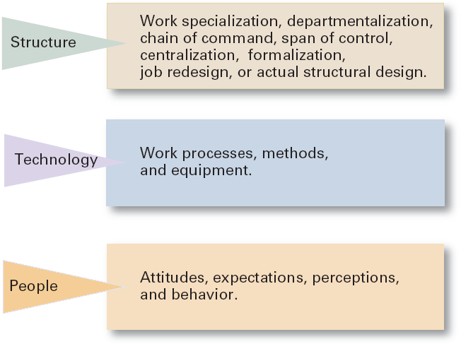
Exhibit 13–2 Three Categories of Change
© 2007 Prentice Hall, Inc. All rights reserved.
13–<number>

Slide 11
Types of Change
Structural
  Changing an organization’s structural components or its structural design
Technological
  Adopting new equipment, tools, or operating methods that displace old skills and require new ones
    Automation: replacing certain tasks done by people with machines
    Computerization
People
  Changing attitudes, expectations, perceptions, and behaviors of the workforce
Organizational development (OD)
  Techniques or programs to change people and the nature and quality of interpersonal work relationships.
© 2007 Prentice Hall, Inc. All rights reserved.
13–<number>

Slide 12

Organizational Development
Organizational Development (OD)
  Techniques or programs to change people and the nature and quality of interpersonal work relationships.
Global OD
  OD techniques that work for U.S. organizations may be inappropriate in other countries and cultures.
© 2007 Prentice Hall, Inc. All rights reserved.
13–<number>

Slide 13
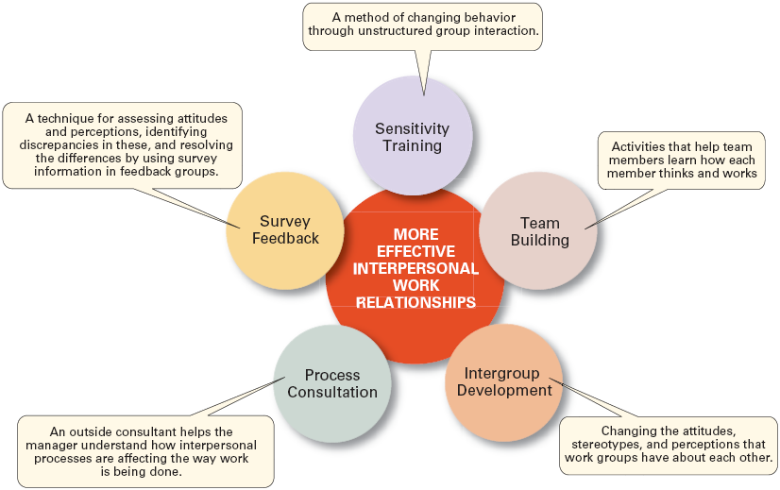
Exhibit 13–3 Organizational Development Techniques
© 2007 Prentice Hall, Inc. All rights reserved.
13–<number>

Slide 14
Managing Resistance to Change
Why People Resist Change?
  The ambiguity and uncertainty that change introduces
  The comfort of old habits
  A concern over personal loss of status, money, authority, friendships, and personal convenience
  The perception that change is incompatible with the goals and interest of the organization
© 2007 Prentice Hall, Inc. All rights reserved.
13–<number>

Slide 15
Exhibit 13–4 Managerial Actions to Reduce Resistance to Change
Education and communication
Participation
Facilitation and support
Negotiation
Manipulation and co-optation
Selecting people who accept change
Coercion
© 2007 Prentice Hall, Inc. All rights reserved.
13–<number>

Slide 16
Issues in Managing Change (cont’d)
Changing Organizational Cultures
  Cultures are naturally resistant to change.
  Conditions that facilitate cultural change:
    The occurrence of a dramatic crisis
    Leadership changing hands
    A young, flexible, and small organization
    A weak organizational culture
© 2007 Prentice Hall, Inc. All rights reserved.
13–<number>

Slide 17
Exhibit 13–5 Strategies for Managing Cultural Change
Set the tone through management behavior; top managers, particularly, need to be positive role models.
Create new stories, symbols, and rituals to replace those currently in use.
Select, promote, and support employees who adopt the new values.
Redesign socialization processes to align with the new values.
To encourage acceptance of the new values, change the reward system.
Replace unwritten norms with clearly specified expectations.
Shake up current subcultures through job transfers, job rotation, and/or terminations.
Work to get consensus through employee participation and creating a climate with a high level of trust.
© 2007 Prentice Hall, Inc. All rights reserved.
13–<number>

Slide 18
Issues in Managing Change (cont’d)
Handling Employee Stress
  Stress
    The adverse reaction people have to excessive pressure placed on them from extraordinary demands, constraints, or opportunities.
    Functional Stress
      Stress that has a positive effect on performance.
  How Potential Stress Becomes Actual Stress
    When there is uncertainty over the outcome.
    When the outcome is important.
© 2007 Prentice Hall, Inc. All rights reserved.
13–<number>

Slide 19
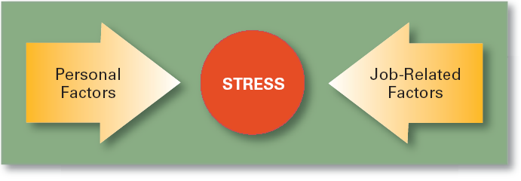
Exhibit 13–6 Causes of Stress
© 2007 Prentice Hall, Inc. All rights reserved.
13–<number>

Slide 20
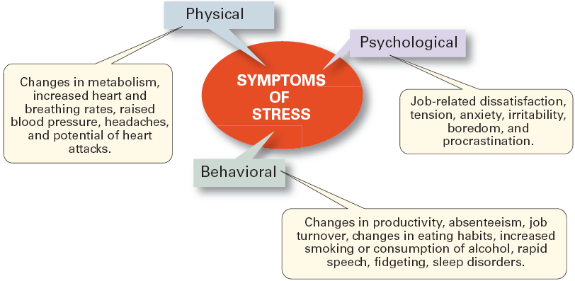
Exhibit 13–7 Symptoms of Stress
© 2007 Prentice Hall, Inc. All rights reserved.
13–<number>

Slide 21
Issues in Managing Change (cont’d)
Reducing Stress
  Engage in proper employee selection
  Match employees’ KSA’s to jobs’ Tasks, Duties, and Responsibilities (TDR’s)
  Use realistic job interviews for reduce ambiguity
  Improve organizational communications
  Develop a performance planning program
  Use job redesign
  Provide a counseling program
  Offer time planning management assistance
  Sponsor wellness programs
© 2007 Prentice Hall, Inc. All rights reserved.
13–<number>

Slide 22
Issues in Managing Change (cont’d)
Making Change Happen Successfully
  Embrace change—become a change-capable organization.
  Create a simple, compelling message explaining why change is necessary.
  Communicate constantly and honestly.
  Foster as much employee participation as possible—get all employees committed.
  Encourage employees to be flexible.
  Remove those who resist and cannot be changed.
© 2007 Prentice Hall, Inc. All rights reserved.
13–<number>

Slide 23
Exhibit 13–8 Characteristics of Change-Capable Organizations
Link the present and the future.
Make learning a way of life.
Actively support and encourage day-to-day improvements and changes.
Ensure diverse teams.
Encourage mavericks.
Shelter breakthroughs
Integrate technology.
Build and deepen trust.
© 2007 Prentice Hall, Inc. All rights reserved.
13–<number>

Slide 24
Stimulating Innovation
Creativity
  The ability to combine ideas in a unique way or to make an unusual association.
Innovation
  Turning the outcomes of the creative process into useful products, services, or work methods.
Idea Champion
  Dynamic self-confident leaders who actively and enthusiastically inspire support for new ideas, build support, overcome resistance, and ensure that innovations are implemented.
© 2007 Prentice Hall, Inc. All rights reserved.
13–<number>

Slide 25
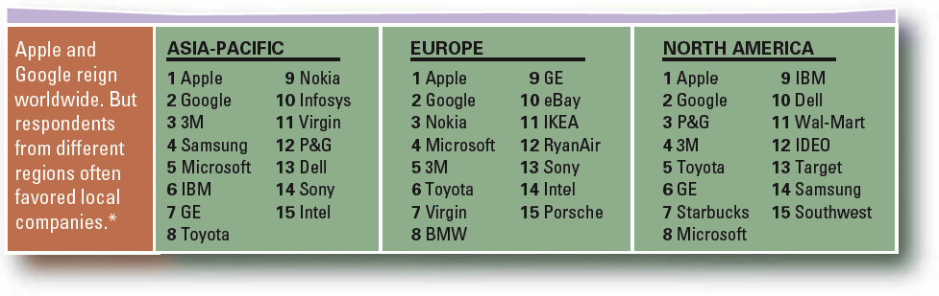
Exhibit 13–9 Innovative Companies Around the World
Data: Boston Consulting Group * We broke ties by comparing 10-year annualized total shareholder returns. In ties between a public and a private company, the public company was favored.
© 2007 Prentice Hall, Inc. All rights reserved.
13–<number>
Source: “A Global Pulse of Innovation,” BusinessWeek, April 24, 2006, p. 74.

Slide 26
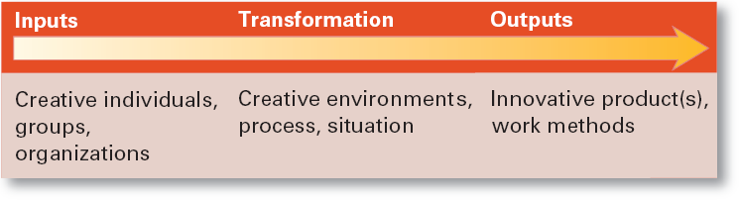
Exhibit 13–10 Systems View of Innovation
Source: Adapted from R.W. Woodman, J.E. Sawyer, and R.W. Griffin, “Toward a Theory of Organizational Creativity,” Academy of Management Review, April 1993, p. 309.
© 2007 Prentice Hall, Inc. All rights reserved.
13–<number>

Slide 27
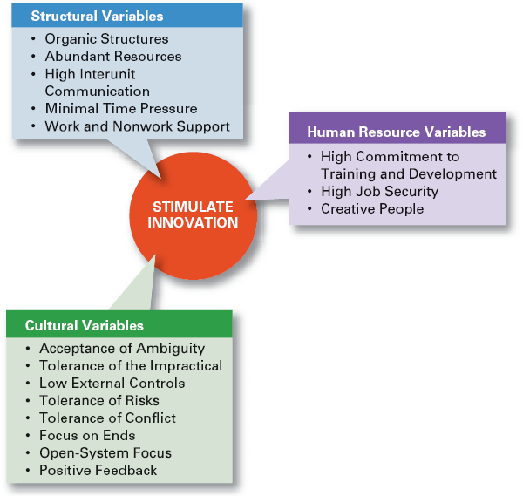
Exhibit 13–11
Innovation Variables
© 2007 Prentice Hall, Inc. All rights reserved.
13–<number>

Slide 28
Creating the “Right” Environment for Innovation
Structural Variables
  Adopt an organic structure
  Make available plentiful resources
  Engage in frequent interunit communication
  Minimize extreme time pressures on creative activities
  Provide explicit support for creativity
© 2007 Prentice Hall, Inc. All rights reserved.
13–<number>

Slide 29
Creating the “Right” Environment for Innovation (cont’d)
Cultural Variables
  Accept ambiguity
  Tolerate the impractical
  Have low external controls
  Tolerate risk taking
  Tolerate conflict
  Focus on ends rather than means
  Develop an open-system focus
  Provide positive feedback
© 2007 Prentice Hall, Inc. All rights reserved.
13–<number>

Slide 30
Creating the “Right” Environment for Innovation (cont’d)
Human Resource Variables
  Actively promote training and development to keep employees’ skills current.
  Offer high job security to encourage risk taking.
  Encourage individual to be “champions” of change.
© 2007 Prentice Hall, Inc. All rights reserved.
13–<number>

Slide 31
Terms to Know
organizational change
change agent
organizational development (OD)
stress
creativity
innovation
idea champion
© 2007 Prentice Hall, Inc. All rights reserved.
13–<number>

